Slide 1


Social media analytics Project: Step 2
The Murder of Roger Ackroyd by Agatha Christie
- Siddheshwari Bankar

Slide 2
Introduction
Author: Agatha Christie
Book Genre: Muder Mystery
Conducting network analysis on the book
Distance metric
Notes:
This is a murder mystery book by Agatha Christie, in which the author uses her classic character Hercule Poirot who is a retired investigator. To give you a brief about the story, in this story a person named Roger Ackroyd is murdered and the protagonist Poirot is investigating the murder. There are many characters involved in this story who had direct connection with Roger and due to that the investigator Poirot has connection with many characters as well since he interrogates a lot of people to find the killer.

Slide 3
Experiments
Playing with different threshold values
1
Tmin = 0.12, Tmax = 2.0
Chosen step size = 0.94 resulting in 21 thresholds
Studying
Detecting communities using Louvain algorithm.
2

Slide 4


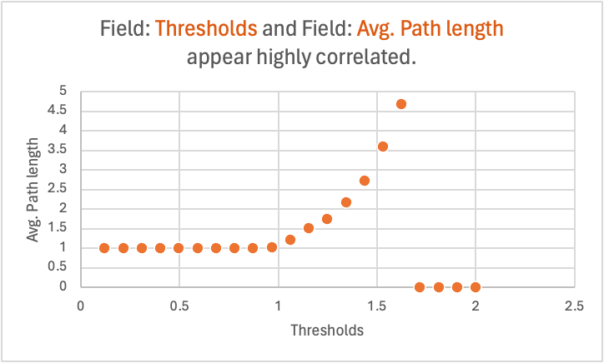
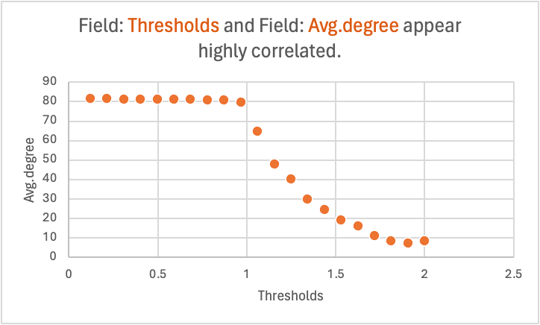
Results

Slide 5
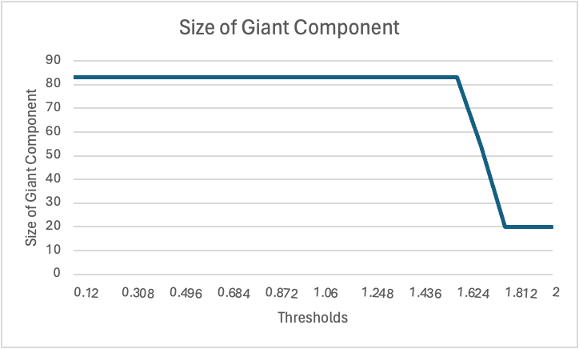
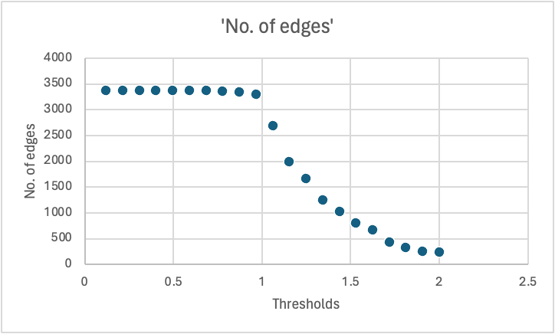
Results

Slide 6
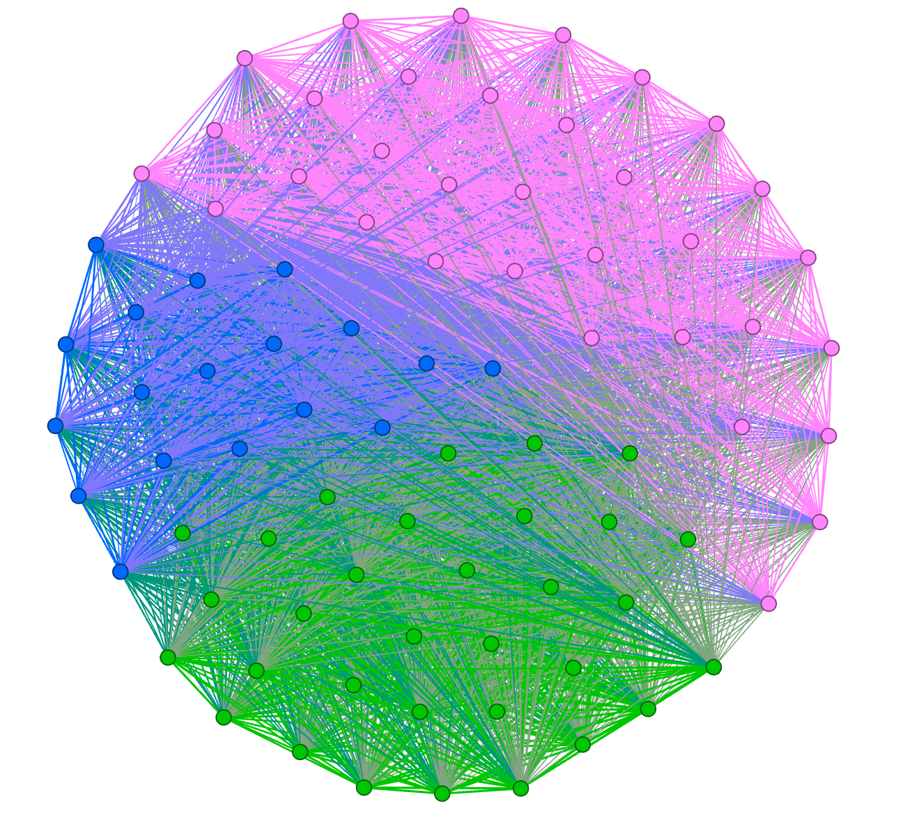
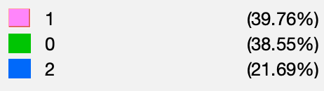
Community detection using Louvain Algorithm

Slide 7
Characters in communities
Commu-nities | Characters
0 | Charles Kent, Paton, Ursula, Miss Russell, Major Blunt, Roger Ackroyd, Ralph, Poirot, Dr. Sheppard, James, Flora, Hector Blunt, Fernly, Ralph Paton, Raymond, Inspector Raglan, Sheppard, Miss Ganett, Miss Ackroyd, Hammond, Geoffrey Raymond, Hercule Poirot, Ursula Bourne, Blunt, Ackroyd, M. Poirot, Raglan, Roger, Melrose, Parker, Flora Ackroyd, Caroline, Ferrars
1 | Mademoiselle, Mademoiselle Flora, Captain Paton, Davis, Folliott, Russell, Mrs. Ferrars, Miss Flora, Elsie Dale, Abbot, Mah Jong, Major Ellerby, Carter, Annie, Ashley Ferrars, Porrott, Hastings, Miss Flora Ackroyd
2 | Hector, Cecil Ackroyd, Mélisande, Clara, Colonel Carter, Miss Sheppard, Rafael Sabatini, Inspector Davis, Cecil, Chow, Diana, Ursula Paton, Miss Caroline, RAGLAN, Monsieur, Hayes, Papa Poirot, Pung, Eh bien, Paddock, Colonel Melrose, ROGER ACKROYD, Ellerby, Bourne, Mademoiselle Caroline, M. Raymond, George Eliot, Elsie, M. le, Mark, ACKROYD, M. l’Inspecteur
Notes:
In community 0, we see central characters like Hercule Poirot, Dr. Sheppard, and Roger Ackroyd listed, along with several other characters who are significantly involved in the main storyline of the novel.
Community 1, groups characters that might share secondary storylines or less frequent interactions with the central figures compared to Community 0
Community 2 contains names that appear to be minor characters or those with less direct involvement in the story's central events, it also includes some repeated names that were not removed initially.

Slide 8

Thank you!

